Slide 1
Bike Case Study

Slide 2
Contents
Analysis Of Customers
Proposed Model
Recommendations

Slide 3
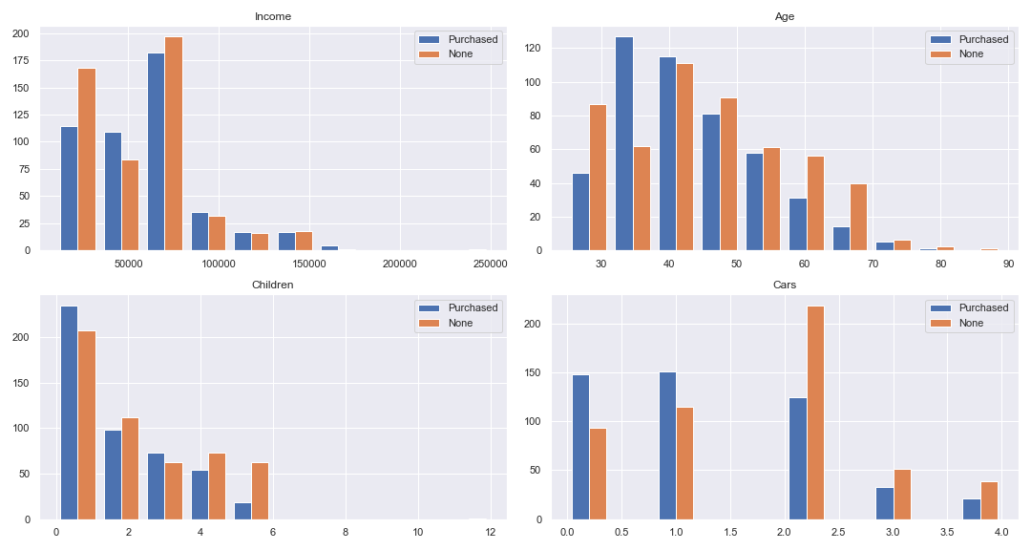
Analysis of Customers
Notes:
Customers are measured on a few variables
Marital Status
Gender
Income
Children
Education
Occupation
Home Owner
Cars
Commute Distance
Region
Age
In analyzing these variables some patterns in buying behavior became apparent.
The above graphs show a group of numeric attributes. Some things to note are,
People with fewer children tended to buy bikes
People with 1 or no cars were a large segment and bought the largest portion of bikes
From 30 to 40 is the biggest proportion of customers to buy a bike.
Other things that were noted

Slide 4
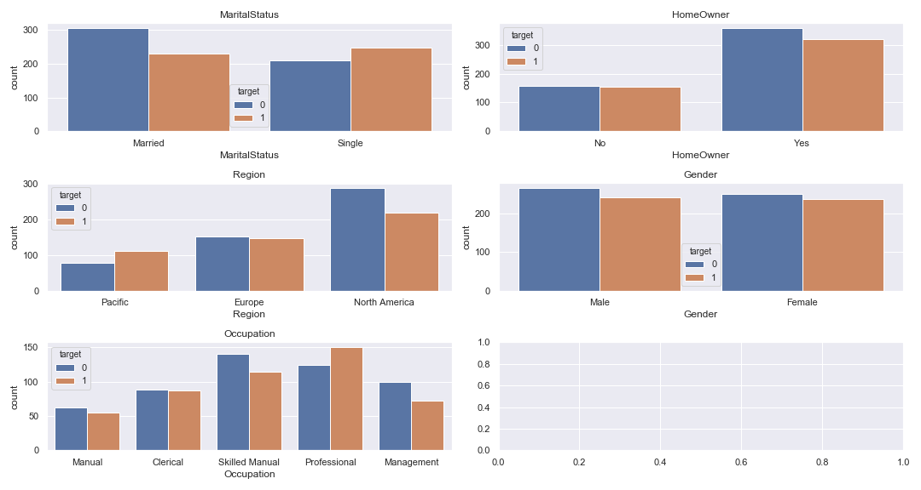
Notes:
More than half of single customers bought a bike.
A bigger percentage of pacific coast customers bought bike, but in straight up number North America had better sales
Skilled manual and professionals are the largest customer base, but professionals are more likely to buy. Target at work functions? Team building?
Homeowners are bigger client base but this doesn’t seem useful for predicting their purchases
Similarly male and female customers to not seem to indicate likelihood to buy.

Slide 5
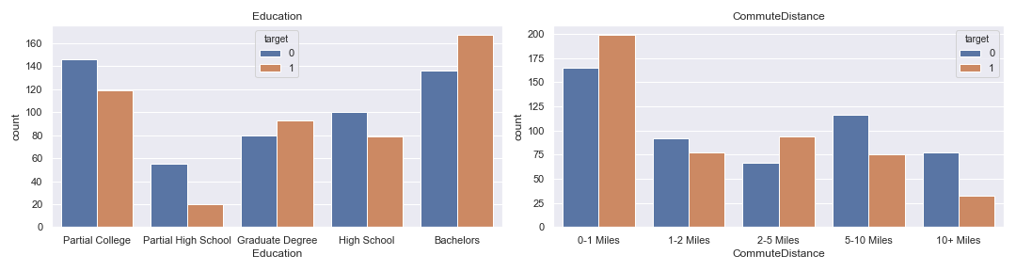
Cont.
Target Market
Ages 30-50s
Professionals
Bachelors and graduate degrees
Incomes less than 100 000
Notes:
Bachelors earners are the largest customer segment, and bought the most bikes. Advertise at graduations?
People with shorter commute distances are larger customer segment and they are more likely to buy bikes.
Who should marketing be aimed at
From the analysis the most lucrative demographic to market to would be 30s-50s, professionals, people with graduate or bachelors degrees, customers earning less than a 100 000 and customers with less than 2 children.
The may also be value in growing the single demographic as that group appear more likely to buy a bike.
As most of the target market are working class reaching out to corporates for to offer test drives to employees could be an exciting way to get new customers interested
Billboards along routes where traffic is likely to build help is likely to reach many interested customers in the above demographic.

Slide 6
Random Forest
Test Accuracy 70%
Advantages of Random Forests
Intrinsically regularizes
Feature importance’s assist in explaining predictions.
Work well with categorical and numerical data
Model Assessment
Metric: Accuracy
Cross validation and standard error
Keep a test set aside that is only applied to the chosen models right at the end.
Notes:
Investigated using KNNs and random forest. The knn had accuracy of (72) but a lower score on the test set (64), this suggests some overfitting. The random forest on the validation set also got 72 on validation and 70 suggesting this will generalize better to new data.
The models were both assessed using cross validation on various hyperparameters, The chosen model hyperparameters were then assessed on 5 k-fold cross validation. This was to ensure there was not a high variance in the model performance indicating an overfit model.

Slide 7
Next steps:
Add new data to improve the model
Previous purchase information
Customer behaviour
Get the model into production
Store the model and use an API endpoint to fetch prediction on a new customers details being added to the website.
Revisit model performance every 10-15 customers to retrain the model and assess for changes in the customers profiles.

Slide 8
Questions?

